Slide 1



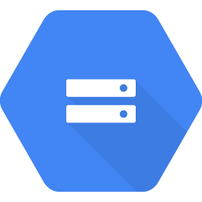
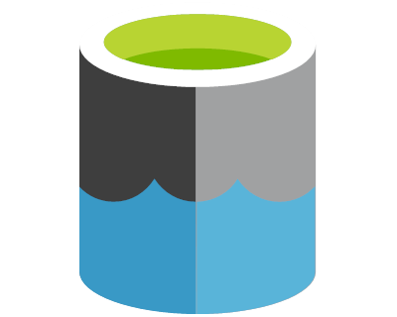



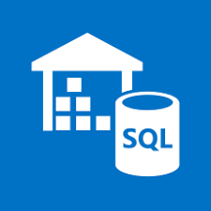



Multicloud Architecture
AWS
GCP
Azure
Data Source
AWS Data Exchange
Bigquery public datasets
Staging
sync
sync
S3
GCS
ADLS
Data Prep
Trifacta
Dataprep
Trifacta
Data Warehouse
Redshift
Bigquery
SQL DW
Business Intelligence
Quicksight
Data Studio
Power BI

Slide 2


Staging Sync For COVID-19
AWS
GCP
Azure
Data Source
To be developed
AWS Data Exchange
Bigquery public datasets
Staging - Primary
trifacta-covid-trifactabucket-q1itzd5kh96
covid_data_raw
Lambda+Cloud Functions
Staging - Replica
gcs-govid-data-raw
gcs-trifacta-covid-trifactabucket-q1itzd5kh96

Slide 3
How It Works
Staging consists of primary and replica buckets
Data first flows into the primary buckets
New objects trigger a Lambda function
automatically copies the data across cloud providers to the replica
AWS Lambda function has corresponding helper functions to act as trigger
Google Cloud Functions
Azure Functions (to be developed)
After replication, each cloud platform has all the datasets in staging (after a few seconds)
You leverage Trifacta in its native platform to wrangle the data
Outputs are stored in each cloud’s native Data Warehouse layer. If you need some outputs to be shared across clouds, you can write it back to primary staging, which gets replicated
Reporting leverages each cloud’s native BI tool

